Slide 1

MINI PROJECT
(COM-312)
Presented By
Amjid Khan (2021A1R106)
Arjumand Ayub (2021A1R111)
Ashu Pal (2021A1R116)
Jatin Koul (2021A1R120)
Submitted To
Miss. Pragti Jamwal
DEPARTMENT OF COMPUTER SCIENCE AND ENGINEERING
MIET(Autonomous), JAMMU

Slide 2
Develop a code to convert virtual address to physical address

Slide 3
TABLE OF CONTENT
PROJECT TITTLE
TABLE OF CONTENT
INTRODUCTON
LOGICAL ADDRESS
PHYSICAL ADDRESS
MEMORY MANAGEMENT UNIT (MMU)
WHY WE NEED TO CONVERT VIRTUAL ADDRESS TO PHYSICAL ADDRESS
MAPPING VIRTUAL ADDRESS TO PHYSICAL ADDRESS
CODE TO CONVERT VIRTUAL ADDRESS TO PHYSICAL ADDRESS
OUTPUTS

Slide 4
INTRODUCTION
Memory is one of the most important host resources. For workloads to access global system memory, we need to make sure virtual memory addresses are mapped to the physical addresses. There are several components working together to perform these translations as efficient as possible. In this miniproject we develop a code to convert a virtual memory address to physical address.

Slide 5
What is logical address ?
Logical Address is generated by CPU while a program is running. The logical address is virtual address as it does not exist physically, therefore, it is also known as Virtual Address. This address is used as a reference to access the physical memory location by CPU. The term Logical Address Space is used for the set of all logical addresses generated by a program’s perspective.
The hardware device called Memory-management Unit is used for mapping logical address to its corresponding physical address.

Slide 6
PHYSICAL ADDRESS
Physical Address identifies a physical location of required data in a memory. The user never directly deals with the physical address but can access by its corresponding logical address. The user program generates the logical address and thinks that the program is running in this logical address but the program needs physical memory for its execution, therefore, the logical address must be mapped to the physical address by MMU before they are used. The term Physical Address Space is used for all physical addresses corresponding to the logical addresses in a Logical address space.

Slide 7
MMU(Memory Management Unit) :
The run time mapping between Virtual address and Physical Address is done by a hardware device known as MMU.
In memory management, the Operating System will handle the processes and move the processes between disk and memory for execution . It keeps track of available and used memory.

Slide 8
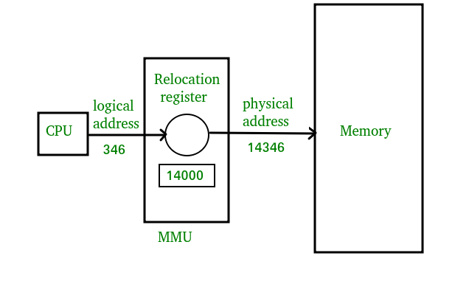
Dynamic relocation using a relocation register.
CPU will generate logical address for eg: 346
MMU will generate a relocation register (base register) for eg: 14000
In memory, the physical address is located eg: (346+14000= 14346)
MMU Scheme:
CPU-----------MMU-----------Memory

Slide 9
WHY WE NEED TO CONVERT VIRTUAL ADDRESS TO PHYSICAL ADDRESS?
To store the data and to manage the processes, we need a large-sized memory and, at the same time, we need to access the data as fast as possible. But if we increase the size of memory, the access time will also increase and, as we know, the CPU always generates addresses for secondary memory, i.e. logical addresses. But we want to access the main memory, so we need Address translation of logical address into physical address.

Slide 10
Mapping Virtual Addresses to Physical Addresses :
In Contiguous memory allocation mapping from virtual addresses to physical addresses is not a difficult task, because if we take a process from secondary memory and copy it to the main memory, the addresses will be stored in a contiguous manner, so if we know the base address of the process, we can find out the next addresses.
The Memory Management Unit is a combination of 2 registers –
Base Register (Relocation Register)
Limit Register.

Slide 11
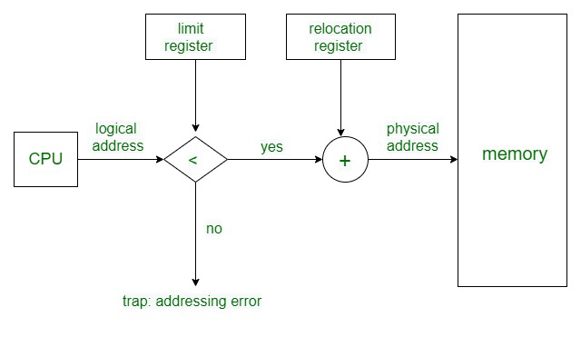
Mapping Virtual Addresses to Physical Addresses :

Slide 12
Code to convert virtual address to physical address
#include <stdio.h>
#include <stdlib.h>
#include <unistd.h>
#include <string.h>
#include <sys/mman.h>
#include <sys/types.h>
#include <sys/stat.h>
#include <fcntl.h>
int main(int argc, char *argv[]) {
// Get the virtual address from the user
printf("Enter a virtual address: ");
char input[128];
fgets(input, 128, stdin);
// Parse the virtual address from the input string

Slide 13
CONTINUE…
void *virtual_address = (void *)strtoul(input, NULL, 16);
// Open the /proc/self/pagemap file
int pagemap_fd = open("/proc/self/pagemap", O_RDONLY);
if (pagemap_fd < 0) {
perror("Error opening /proc/self/pagemap");
return 1;
}
// Seek to the correct entry in the pagemap file
off_t pagemap_offset = (unsigned long)virtual_address / getpagesize() * 8;
if (lseek(pagemap_fd, pagemap_offset, SEEK_SET) != pagemap_offset)

Slide 14
CONTINUE…
perror("Error seeking in /proc/self/pagemap");
return 1;
}
// Read the entry from the pagemap file
unsigned long pagemap_entry;
if (read(pagemap_fd, &pagemap_entry, 8) != 8) {
perror("Error reading from /proc/self/pagemap");
return 1;
}
// Extract the physical page number from the pagemap entry
unsigned long physical_page_number = pagemap_entry & ((1ull << 55) - 1);

Slide 15
CONTINUE…
// Compute the physical address by adding the offset within the page
void *physical_address = (void *)(physical_page_number * getpagesize() +
(unsigned long)virtual_address % getpagesize());
printf("Virtual address: %p\n", virtual_address);
printf("Physical address: %p\n", physical_address);
return 0;
}
/*This program prompts the user to enter a virtual address and then uses the /proc/self/pagemap file to look up the corresponding physical address. The /proc/self/pagemap file is a special file that is provided by the Linux kernel and contains the entries in the current process's page table.
Keep in mind that this is just one way to convert a virtual address to a physical address, and the exact method for doing so will depend on the specific operating system and hardware being used.
*/

Slide 16
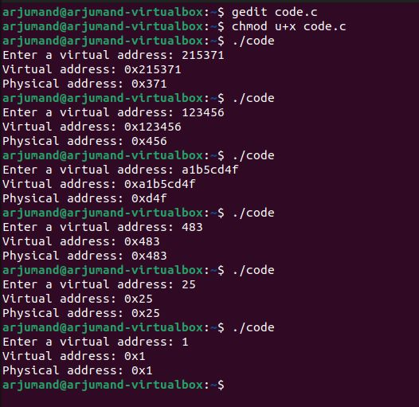
OUTPUTS:

Slide 17
THANK YOU

